Slide 1
Evaluating the potential integration of prophylactic health products (PHPs) into Kenyan tilapia farmers’ health management practices: A Mixed Methods Study
Michael Ouya

Slide 2
Contents
Introduction
Research questions
Study Design
Fish Farmer Health Survey
Qualitative Results
Quantitative Results
PHP Outlet (Agrovet) Survey
Qualitative Results
Quantitative Results
Conclusions
Limitatos

Slide 3
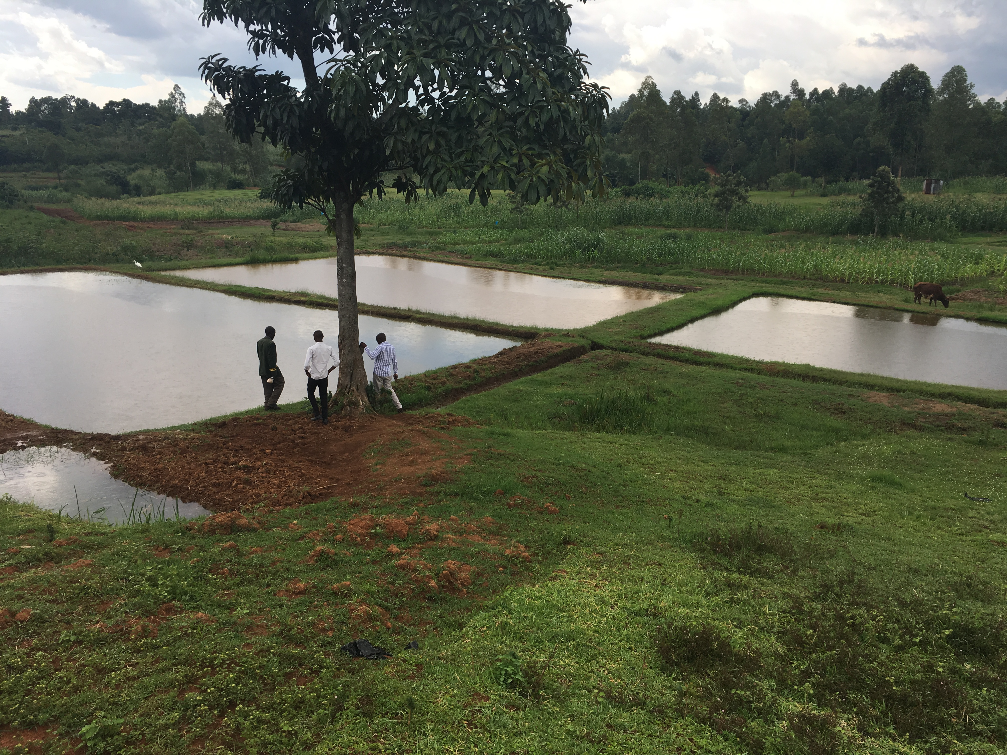
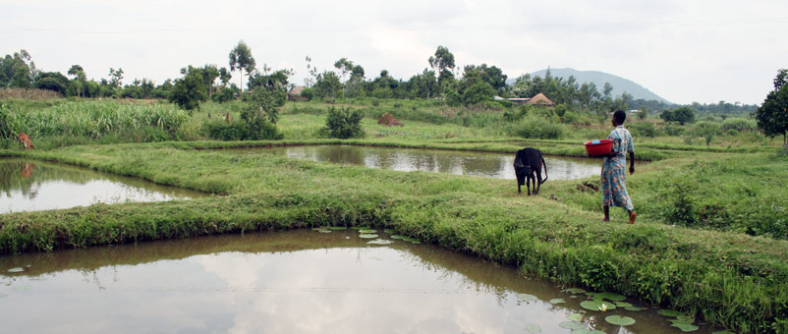
Introduction
Nascent aquaculture industry – 12,154mT p/a
1.4 million ha potential aquaculture sites (Munguti, 2014)
0.014% in use (Munguti, 2014)
Intensifying production = ↑ Disease risk
Tilapia Lake Virus
Isolated in Egypt
Prophylactic Health Products?
Michael Ouya, 2017
Farm Africa, 2017
Notes:
Kenya is a country with a nascent aquaculture industry. Tilapia is the primary food fish consumed, 80% of which comes from capture fisheries around Lake Victoria. Aquaculture is quickly gaining ground as farmers seek to capitalise on the 1.14million ha of potential aquaculture sites in both land and water based systems. Ponds remain the favoured production system, accounting for 95% of tilapia aquaculture production, however cages have quickly gained popularity, with an estimated 2000 cages placed into the lake in the last 3 years.
It has previously been shown that farmer diagnostic capabilities have been improved through the incorporation of prophylactic health products into their health management practices.

Slide 4
Prophylactic Health Products
Probiotics
Alter the microbial balance in the gut
Sustainable alternative to antibiotics
Allows greater access to export markets
Reduces the occurrence of antibiotic resistant bacteria
Notes:
Prohylactic health products include a wide variety of preventative pharmaceutical therepeutants. This study looked specifically at Probiotiscs and Yeast-derived immunimodulators.
Probiotics, or good bacteria, widely known for their uses in human health are loosely definied as a live microogoranism which when administered to an animal confers a host of health benefits,
Yeast innunomodulators

Slide 5
Aim & Research questions
Aim: To improve farmer diagnostic capabilities through improved access to PHPs
What factors shape tilapia farmer perceptions and practices around health management
How do these factors vary across enterprise scales and production systems
What are the recent trends and practices around PHP use in the Kenyan livestock sector?
What can be learned from the livestock sector regarding the potential future uptake of PHPs
Notes:
Overall, this study attempted to improve the diagnostic capabilities of the small scale Kenyan tilpia farmer through improved access to PHPs. As suc it was necessary to understand the factors shaping their current perceptions and practices to health management in order that their suitability for PHP intergration could be assessed
It was necessary to understand the trends surrounding PHP use in the Kenyan livestock sector, because evidence suggests that aquaculture’s trajectory with intensification closely follows that of the livestock industry.
And it was necessary to intergrate information from the two sectors in order that we could understand how best the PHPs could be intergrated into the tilapia farmers health management practices.

Slide 6
Study Design
Qualitative Data Collection and Analysis
Qualitative Stage
Qualitative Results
2 part study
Fish health survey
PHP outlet survey
Exploratory sequential mixed methods design
Qualitative results used to form questionnaires for quantitative data collection
Analysis
Quantitative data collection
Quantitative Stage
Qualitative Results
Combined analysis of qualitative and quantitative results to draw conclusions
Analysis
Cresswell, 2015
Notes:
This was a 2 part study. We attempted to answer the first of our research questions using a fish farmer health survey and the remaining two using an outlet survey. The study was conducted using an exploratory sequential mixed methods design, in which an inital exploratory phase was used to collect qualitative data and a secondary phase used to collect qualitative data.
This was done because the subject area is not very well understood and the qualitative data would help us form a robust questionnaire from which solid conclusions could be drawn.

Slide 7
Fish Health Survey
Qualitative Data Collection and Analysis
Qualitative Stage
Research question:
What factors shape tilapia farmer perceptions and practices around health management
How do these factors vary across enterprise scales and production systems
12 KI interviews
Disease experts
Intensive Cage Farmers
Feed Distributors
Aquaculture Academics
Questionnaire implemented with farmers
Qualitative Results
Qualitative results used to form questionnaires for quantitative data collection
Analysis
Quantitative data collection
Quantitative Stage
Qualitative Results
Combined analysis of qualitative and quantitative results to draw conclusions
Analysis
Notes:
The fish health survey attempted to understand the factors shaping tilapia farmers’ health practices surrounding health management across production scales and enterprise sizes. 12 semi structured interviews were conducted with respondents ranging from Kenyan fish disease experts to Aqquaculture academics as we attempted to paint a picture of the state of fish disease in the country.

Slide 8
Fish Health Survey
Qualitative Data Collection and Analysis
Indicators of Intensification
Feed
Monosex fingerlings
Stocking densities
Disease:
Low levels in Kenyan aquaculture due to low levels of intensity
Higher intensity cage farmers likely to experience diseases first
Diagnostic Capabilities
Farmers largely unaware of the threat posed by disease
Poor governmental support for farmers experiencing diseases
PHP use
No use of PHPs in Kenyan aquaculture
Qualitative Stage
Qualitative Results
Qualitative results used to form questionnaires for quantitative data collection
Analysis
Quantitative data collection
Quantitative Stage
Qualitative Results
Combined analysis of qualitative and quantitative results to draw conclusions
Analysis
Notes:
In understanding the disease risks in Kenyan aquaculture it was necessary to obtain some country-specific indicators of aquaculture intensification; such that we could ascertain the level of aquaculture intensification and so the risk of disease. KIs responses regarding indicators of intensification were tallied and the top 3 selected for analysis. These included Feeds – where nutritionally complete formulated feeds signalled higher intensity production, monosex fingerlings, where a greater percentage of monosex fingerlings signalled higher intensity and Stocking density, where high stocking densities signalled higher intensity,
The KI interviews further suggested that there was a low level of disease in Kenyan aquaculture with respondents suggesting that stocking densities etc werent high enough to proomte high levels of disease
It was further suggested that the high intensities associated with cage farmers would cause an uptake in disease. Also because so many have been put into the water with no environmental regulations, it is thought that disease could come rapidly
Similarly, it was suggested that farmers have poor diagnostic capbilities, with levels of education being so low that people would not know if a disease hit them
Also, it was suggested that farmers were not using any PHPs for aquaculture

Slide 9
Farmer Fish health Survey
Qualitative Data Collection and Analysis
Qualitative Stage
Questionnaire elicited information on:
Perceptions of Disease
Perceptions of Mortalities
Feeds
PHP use
Fingerlings stocked
Stocking densities
Constraints to production
Qualitative Results
Qualitative results used to form questionnaires for quantitative data collection
Analysis
Quantitative data collection
Quantitative Stage
Qualitative Results
Combined analysis of qualitative and quantitative results to draw conclusions
Analysis
Notes:
Following on from the initial exploratory stage, we constructed a questionnaire to collect information on perceptions of disease and mortalities in order to answer out research question regarding farmer health management perceptions
Feeds, Fingerling and Stocking density data were collected to understand the indicators of aquaculture intensification and Data pertaining to PHP use was also collected in the hope that the characteristics of farms using PHPs could be used as a benchmark or sample showing the level of intensity at which PHPs are adopted

Slide 10
Fish Health Survey
Multiphase stratified sampling
50 farmers sampled across production systems
Table 2. Summary of census population and selected sample frame.
Census
County | % Pond | % Cage | Total
Kakamega | 100% | 0% | 199
Siaya | 26% | 74% | 117
Homa Bay | 85% | 15% | 144
Total | 76% | 24% | 460
Sample Frame
County | % Pond | % Cage | Total
Kakamega | 100% | 0% | 21
Siaya | 25% | 75% | 16
Homa Bay | 85% | 15% | 13
Total | 72% | 28% | 50
Google mymaps, 2017
Notes:
We obtained two censuses of cage and pond farmers in the region and compiled the two to form the basis of our stratified sample frame. The census showed the the greatest number of farmers in the country were in the counties of Siaya, Kakamega and Homa Bay.
As you can see, we tried to keep the farmer population densities in line with those reflected in the census. This was done to improve the generalisability of our data. 50 respondents wereseclected across production systems.

Slide 11
Fish Health Survey
What factors shape tilapia farmer perceptions and practices around health management
How do these factors vary across enterprise scales and production systems
Table 3. Summary of farm scales by total pond area and total selected respondents
Production System | Scale | Total Area | Frequency | % of Total
Pond | Small-scale | <750m² | 14 | 29%
 | Medium-scale | 750m² – 2000m² | 14 | 29%
 | Large Scale | >2000m² | 6 | 13%
Cage | Cages | N/A | 14 | 29%
Total |  |  | 48 | 100%
Notes:
In order to assess the potential factors affecting farmer perceptions of health management, we stratified the sites by scale based on the total pond area per site. The sample size for cages was too small to analyse significant differences between site scales. The scaling variables were informed by Key Informant interviews

Slide 12
Quantitative Results: Indicators of intensification
Use of nutritionally complete formulated feeds
High stocking densities
Use of monosex fingerlings
Table 6. Summary of site characteristics by farm scale.
Production System | Scale | Fingerling sex (% monosex) | Pond Type | Median Culture Units [IQR]^{c} | Mean Stocking Density [SD] ^{d,e}
Pond | Small-scale | Mixed and Monosex (78%) | Earthen | 2 [1] | 3.77[0.62]
 | Medium-scale | Mixed and Monosex (78%) | Earthen and Liner | 4 [3] | 3.14 [0.376]
 | Large-Scale | Mixed and Monosex (83%) | Earthen and Liner | 10 [9] | 2.20 [0.374]
Cage | Cages | Monosex (100%) | Square metal cages with floats | 15 [36] | 184 [15.6] (m³)
Notes:
As a part of understanding the comparative intensity of our study sites and thus the likelihood of disease occurrences it was vital to understand the industry specific indicators of intensification. As shown here there was a general trend towards more more monosex ponds with increasing farm scale. Conversely however there was a decrease in stocking density with increasing farm scale.

Slide 13
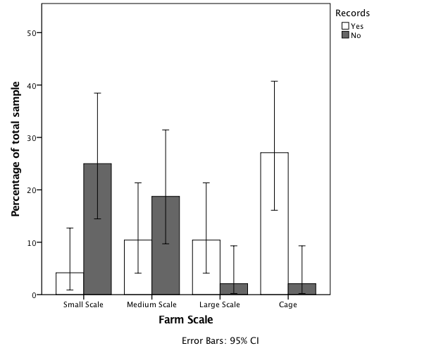
Quantitative Results: Indicators of intensification
Poor farmer recall
Absence of records
Inconclusive results
Notes:
We discounted the data on stocking density and monsex fingerlings because it became apparent that farmers did not maintain records to a degree at which their reports of monosex fingerlings and stocking densities could be independently verified. However in all cases, we could confirm the feeds used on site through observations of feed bags, and so we decided that the prevalence of commericial feeds was the best indicator of intensification.

Slide 14
Feed Intensity Index
Table 4. Summary of Feed Intensity (FI) Index
Feed Intensity Index (FI) (Feed intensity) | Quality Indicator | Key Ingredient | Characteristics (Feed form)
1 (Low Intensity) | Homemade | Wheat Bran Sunflower cake Rice Bran | Poor quality (Mash)
2 (Mid-Low Intensity) | Locally Produced | Wheat Bran Sunflower cake Rice Bran | Poor quality (Sinking pellets)
3 (Mid-High Intensity) | Locally formulated | Soybean meal | Good quality (Floating pellets)
4 (High Intensity) | Imported formulated | Fish meal | Nutritionally complete (Floating pellets)
Notes:
A feed intensity index was devised to characterise the various farm intensities. Every feed type used on the farm was assigned a score based on how intensive the feed was and a mean taken to calculate a Feed intensity index score for each site, where 1 was the lowest intensity and 4 the highest.

Slide 15
Feed Intensity Index
Clear trend towards more intensive feed uses in larger pond farms and amongst cage farms
Notes:
Cage sites were found to be significantly more intensive than pond sites, confirming KI thoughts that disease would likely strike there first. There was also a trend towards higher feed intensity with increased farm scale, with significantly fewer larger scale farms using homemade feeds than their small scale counterparts.

Slide 16
Diagnostic Capabilities
9% (n=48) of farmers with training across production systems
77% (n=9) of those trained could not name a disease
Cage farmers with lower levels of health training than pond farmers
Table 9. Summary of farmer fish health training by production systems
Institution | Institution Type | Pond farmers | Cage Farmers
GIZ | NGO | 1ª | 1
Jewlett | Commercial Hatchery and Feed producer | 2 | -
Department of Fisheries | Government Office | 2 | -
AASK | Cooperative | 1 | -
Aller-Aqua | Feed Producer | - | 1
FAO | NGO | 1 | -
Notes:
After characterising the various levels of intensity across production systems, we looked at farmer diagnostic capabilities, finding that (as suggestedd by the KI interveiws) very few farmers had any form of fish health training. 77% of those trained however could not name a signle fish disease, and further the more intensive cage sites

Slide 17
Fish Health Survey
Research question:
What factors shape tilapia farmer perceptions and practices around health management
How do these factors vary across enterprise scales and production systems
Notes:
Similarly farmers were asked whether they had experienced significant mortalities at any point in the last year of production. It was observed that disease became more of problem amongst larger scale pond farms, with significantly more cage farmers reporting mortalities and disease than pond farmers.

Slide 18
Fish Health Survey: Constraints to production
Table 12. Summary of reported challenges faced by farmers by production system
Category | Reported Challenge | Pond | Cage | Total
Feed | High cost of Feed | 19 | 6 | 25
 | Lack of quality Feed | 7 | 2 | 9
Seed | High cost of Seed | 1 | - | 1
 | Lack of quality seed | 9 | 2 | 11
Market | Access to Market | 6 | 6 | 12
 | Access to Credit | 1 | 3 | 4
 | Capital | 3 | 3 | 6
Logistics | Lack of Equipment | 4 | - | 4
 | Lack of Governmental Support | - | 3 | 3
 | Security | 3 | 2 | 5
Environmental | Algal Blooms | - | 2 | 2
 | Drought | 9 | - | 9
 | Flooding | 1 | - | 1
 | Predation | 14 | 1 | 15
 | Tidal destruction | - | 1 | 1
 | Water Hyacinth | - | 3 | 3
None | None | 3 | - | 3
Notes:
In trying to understand the factors shaping health management practices we looked at the challenges reported by farmers. They were asked to rank 3 of the biggest challenges to production. It was clear that the cost of feed was the greatest constraint to farmers across production systems.

Slide 19
PHP Outlet Survey
Qualitative Data Collection and Analysis
Qualitative Stage
Research question:
What are the recent trends and practices around PHP use in the Kenyan livestock sector?
Qualitative Results
Qualitative results used to form questionnaires for quantitative data collection
Analysis
Quantitative data collection
Quantitative Stage
Qualitative Results
Combined analysis of qualitative and quantitative results to draw conclusions
Analysis
Notes:
The second part of the study used the same mixed methods design and looked at the trends and practices surrounding PHP use in the livestock sector.

Slide 20
Qualitative Results: PHP Outlet Survey
Qualitative Data Collection and Analysis
Qualitative Stage
PHPs in Livestock
Entered the market in 2007
Chiefly used among ‘super-intensive’ poultry producers
Antibiotics significantly more popular
Factors affecting PHP use
Too expensive for livestock producers
Uptake amongst producers driven by agrovets
Qualitative Results
Qualitative results used to form questionnaires for quantitative data collection
Analysis
Quantitative data collection
Quantitative Stage
Qualitative Results
Combined analysis of qualitative and quantitative results to draw conclusions
Analysis
Notes:
Again, KI interviews were conducted with experts to understand how PHP use has evolved in the Kenyan livestock production industry. It was found that PHPs rose to prominence in the late 2000s, however their use is largely restricted to super intensive poultry producers who serve multinational clientele, who don’t want antibiotics in their livestock. Smaller scale intensive producers were said to favour antibiotic therapies ovet those of PHPs primaril because of the cost.
Interestingly, it was further found that the rise of PHPs has been due to PHP outlets looking to make some extra money pushing the products at expo shows and farmer fairs.

Slide 21
PHP Outlet Survey
Qualitative Data Collection and Analysis
Qualitative Stage
Questionnaire elicited information on:
Prevalence of PHPs
Popular chemicals used in livestock production
PHPs for aquaculture
Trends in PHP sales
Qualitative Results
Qualitative results used to form questionnaires for quantitative data collection
Analysis
Quantitative data collection
Quantitative Stage
Qualitative Results
Combined analysis of qualitative and quantitative results to draw conclusions
Analysis
Notes:
Based on the results of the KI interveiws we again constructed a questionnaire to ascertain the actual trends in PHP use among PHP vendors. We looked at the prevalence of PHPs, the popular chemicals used in livestock health production, PHPs in use for aquaculture and the trends in PHP sales all with a view to mapping a trajectory for PHP use in aquaculture

Slide 22
PHP Outlet Survey
Study Sites informed by KI interviews
50 respondents from 5 towns and cities
Convenience Sampling
2-week time constraint
Town | Respondents
Nairobi | 16
Thika | 16
Kitengela | 8
Ruiru | 7
Kiambu | 3
Google mymaps, 2017
Notes:
The questionnaire was implemented in the 5 towns with the highest number of Agrovets supplying intensive livestock producers as informed by KI interviews.
A convenienec sampling method was used because of the time constraints.

Slide 23
PHP Outlet Survey
Qualitative Data Collection and Analysis
Qualitative Stage
Popular livestock health products (n=50)
Antibiotics – 62%
Dewormers – 23%
Vitamins – 11%
PHPs – 0%
No PHPs for aquaculture
Qualitative Results
Qualitative results used to form questionnaires for quantitative data collection
Analysis
Quantitative data collection
Quantitative Stage
Qualitative Results
Combined analysis of qualitative and quantitative results to draw conclusions
Analysis
Notes:
The results were as suggested by the KIs, we found very little use of PHPs in the livestock sector. It was found that antibiotics were the favoured chemotherapeutant across outlets, and that at present there are no aquaculture PHPs being sold

Slide 24
Conclusions
What factors shape tilapia farmer perceptions and practices around health management?
Low levels of intensity
Access to capital
Poor diagnostic capabilities
What are the recent trends and practices around PHP use in the Kenyan livestock sector?
Used predominantly in intensive poultry production
Cost is a massive barrier to uptake amongst smaller producers
What can be learned from the livestock sector regarding the potential future uptake of PHPs
Feed companies are unlikely to play a part in PHP uptake
Entry point likely to be Agrovets
Notes:
Going back to the research questions we found that farmers were of the perception that disease was not a major constraint to production. This was likely due to the low levels of aquaculture intensification in the area. Further a lack of access to capital my be breeding an attitude in which farmers cannot “afford” to be concerned with diseases while costs of feed remain high. Similarly poor diagnostic capabilities and a lack of health management training may be having the effect of making farmers unaware of the threats of disease
The trends and practices surrounding PHP use further showed that uptake is low and PHPs use is not prevalent, solely amongst poultry producers. It also showed that the cost of PHPs proves a barrier to their uptake
Lastly, it was shown that feed companies will be unlikely to play a part in the uptake of PHPs due to the low value of tilapia, and that the likely entry point to market of PHPs will be agrovets or PHP outlets.

Slide 25
Limitations
Feed Intensity Index
Does not account for amounts fed
Convenience sampling
Inaccurate representation of outlets
Poor farmer recall
Difficulty triangulating results
Notes:
Study had limitations, the FI did not account for amounts of feed, conviencnceis not robuse, and poor farmer recall combined with poor records meant that in many cases farmer responses could not be triangulated

Slide 26
Acknowledgements
Dr. Francis Murray
William Leschen
Dr. Patricia Muendo
BBSRC
IMAQulate
University of Machakos

Slide 27
References
Cruz, M.P. et al., 2012. Use of Probiotics in Aquaculture a n. Reviews in Aquaculture, 5(6), pp.1–13.
Creswell, J.W., 2015. EDITION 1st ed. V. Knight, S. Connelly, & L. Habib, eds., California: SAGE Publications Inc.
Munguti, J.M., Kim, J. & Ogello, E.O., 2014. An Overview of Kenyan Aquaculture : Current Status , Challenges , and Opportunities for Future Development. Fisheries and Aquatic Sciences, 17(August 2013), pp.1–11.

